Slide 1
Brent Oil Price Forecasting

Slide 2

01
Oil Price
What causes Oil Price Fluctuations?
Brent Oil Price history
02
Time-Series Forecasting
CONTENTS
Methodologies
03
Variables
Which exogenous variables are chosen
04
Results
Model Outputs
05
Streamlit
Forecasting App

Slide 3
What causes Oil Price Fluctuations
01
Supply and demand
Innovations in energy
Seasonal swing
World events
COVID Pandemic
Russia Ukraine War
Low US output
Diminished OPEC output

Slide 4
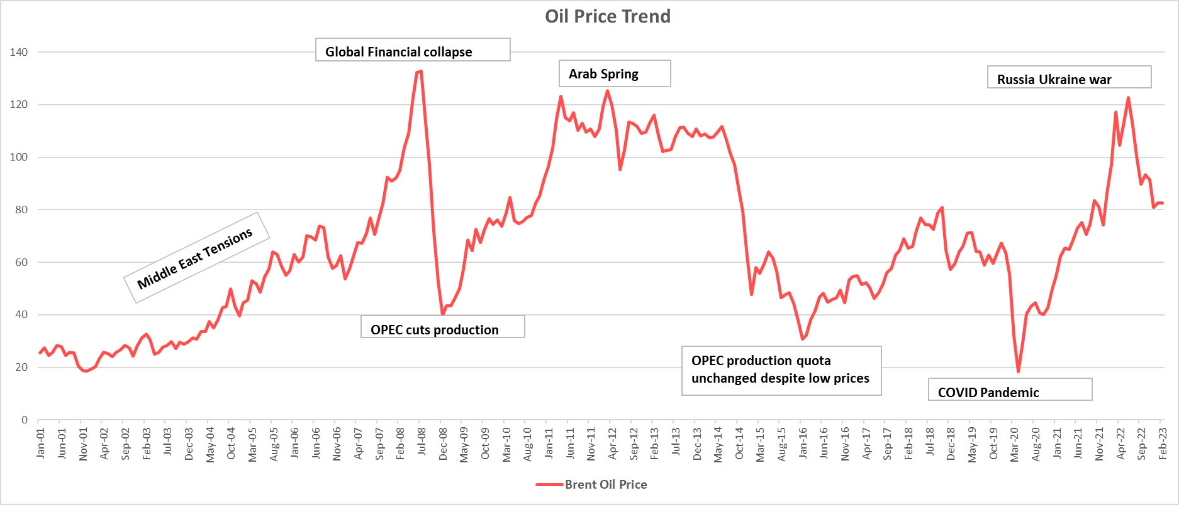
Brent Oil Price history
01

Slide 5
Time-Series Forecasting
02
ARIMAX model: AR(p), MA (q), I (d)
SARIMAX model: seasonality and exogenous variables
FB Prophet

Slide 6
03
Model Variables
Output variable: Oil Price
Input Variables:
-GDP (Gross Domestic Product)
-PCE (Private Consumption Expenditure)

Slide 7
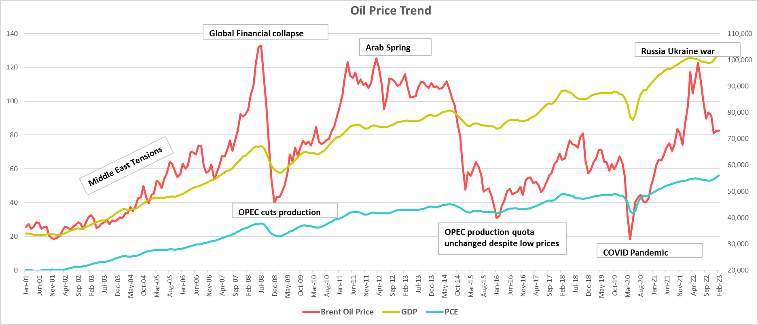
Oil Price vs. GDP/ PCE
03

Slide 8
Model Results: Testing accuracy
Train Period: Jan’2001-Feb‘ 2022
Test Period : Mar‘ 2022 – Feb‘2023
TEST PERIOD MAPE: 15
Actuals higher than forecasted

Slide 9
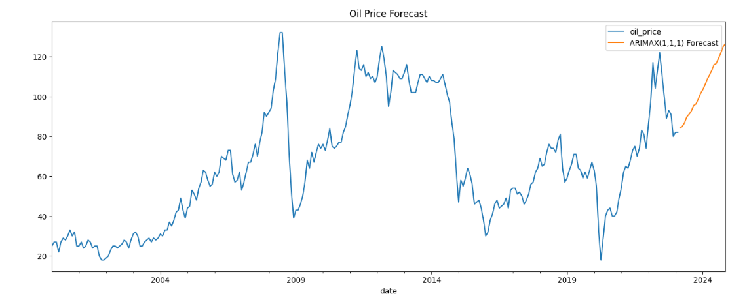
ARIMAX: Model Results
Forecast for next 20 months
Forecasted Period: Mar’23 – Nov‘24

Slide 10
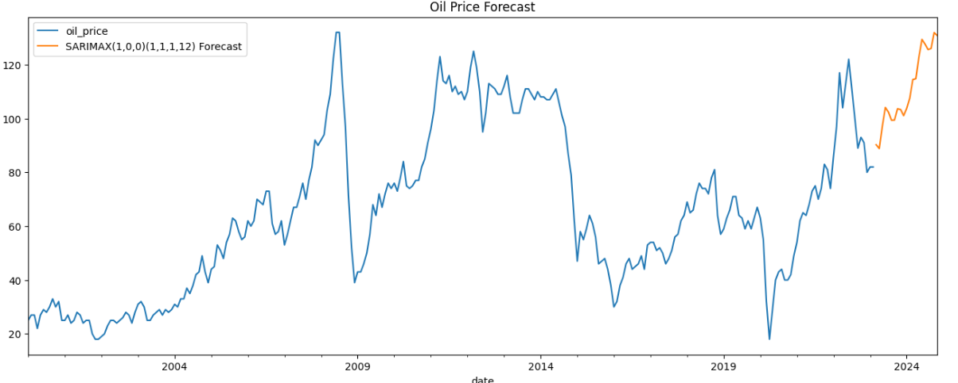
SARIMAX: Model Results
Forecast for next 20 months
Forecasted Period: Mar’23 – Nov‘24

Slide 11
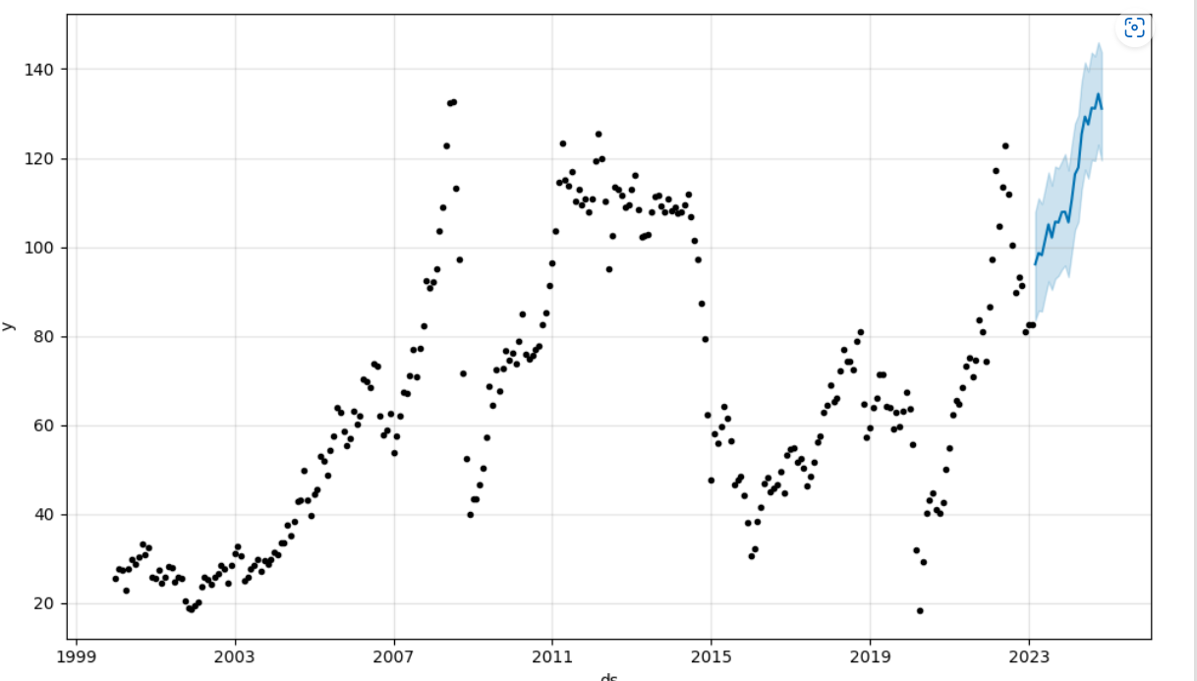
Prophet: Model Results
Forecast for next 20 months

Slide 12
Model Comparisons:
FCST Period

Slide 13
Conclusion
Both SARIMAX & Prophet works well with seasonal series
Bright outlook

Slide 14
THANK YOU

